Slide 1
Machine Learning
Unit - 01

Slide 2

Introduction to Machine Learning

Slide 3
what is machine learning?
Machine Learning (ML) is the science/art of programming a computer so it can learn from data.
(A. Samuel, 1959) ML is the field of study that gives a computer the ability to learn without being explicitly programmed.
(T. Mitchell, 1997) A computer program learns from experience E with respect to some task T and some performance measure P, if its performance on T, as measured by P, improves with experience E.
Example:
A spam filter is a ML program that, given examples of spam emails (flagged by users) and examples of non-spams emails, can learn to flag spam. The examples that the system uses to learn are called the training set.
The part of the ML system that learns and makes predictions is the model.

Slide 4
DATA SCIENCE
AI:
medical diagnosis to predict possible diseases
Robotics
Automated customer support
Data visualization
Statistical analysis
Market research analysis
Customer segmentation
Expert Systems
Rule-Based Systems
Logic Programming, Symbolic AI
(e.g. Chess Playing Program)
GPS Navigation Systems
Chatbots with Pre-defined Responses
Machine Learning:
Computer programs that learn from data
Non DNN
Decision trees
Random forest
Support vector machines
Linear/logistic regression
K-Nearest neighbors
Deep Learning (DNN)
Image recognition, Self driving vehicle
Virtual Assistant (Alexa, Siri …)
Speech recognition
Machine translation
Fraud detection
Text summarization
ChatGPT

Slide 5
Why use ML?
Machine Learning is great for:
Problems for which existing solutions require a lot of fine-tuning or long lists of rules (ML model can often simplify code and perform better than traditional approaches, e.g spam filter)
Complex problems for which traditional approaches yield no good solution ( the best ML techniques can (perhaps) find a solution, e.g. speech recognition)
Fluctuating environments (a ML system can easily be retrained on new data, always keeping it up to date)
Getting insights about complex problems and large amounts of data (data mining)

Slide 6
Examples of applications
Analyze images of products on a production line to automatically classify them (image classification using convolution neural network (CNN) or transformers)
Detect tumors in brain cells (semantic image segmentation, each pixel is classified using CNN, transformers)
Automatically classify news articles (natural language processing (NLP) using recurrent neural networks (RNN) and CNN, or transformers)
Automatically flag offensive comments on discussion forums (text classification like for NLP tools)
Create a chatbot or a personal assistant (NLP components)

Slide 7
Examples of applications
Forecast next year’s company’s revenue based on several performance metrics (regression task that predicts a value)
Detect credit card fraud (anomaly detection)
Segment clients based on purchasing patterns to design a different marketing strategy for each segment (system clustering).
Build an intelligent bot for a game (use reinforcement learning)

Slide 8
Types of ML Systems
There are many different types of machine learning systems that it is useful to classify them in broad categories, based on the following criteria:
How they are supervised during training (supervised, unsupervised, semi-supervised, self-supervised, etc…)
Whether or not they can learn incrementally on the fly (online versus batch learning)
Whether they work by simply comparing new data points to known data points, or by detecting patterns in the training data and building a predictive model (instance-based versus model-based learning).

Slide 9
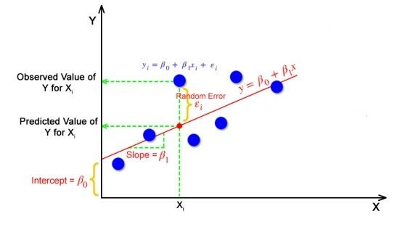
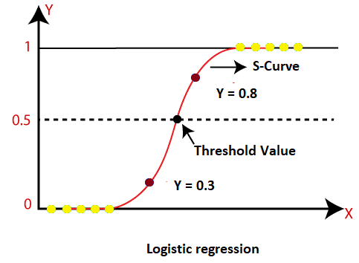
Examples of Machine Learning Algorithms
Linear Regression: used for predicting continuous numerical values based on a linear relationship between input variables and the output. (Predict the price of a house based on its square footage)
Logistic Regression: used mostly for classification tasks, predicting the probability of a binary outcome based on input features. (Predict whether a patient will develop a specific disease based on medical history)

Slide 10
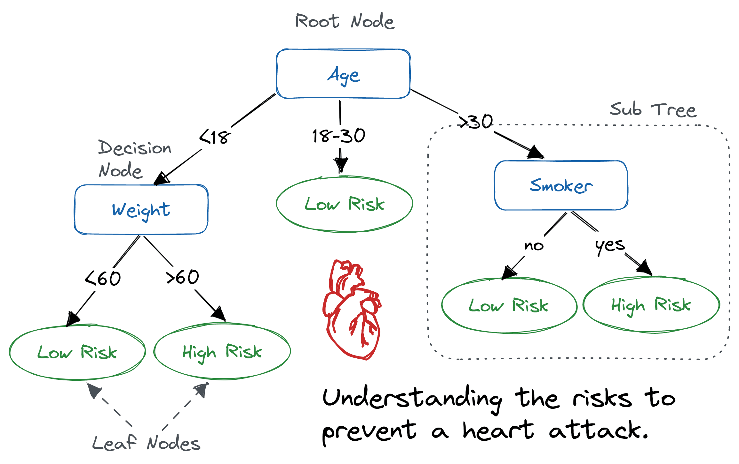
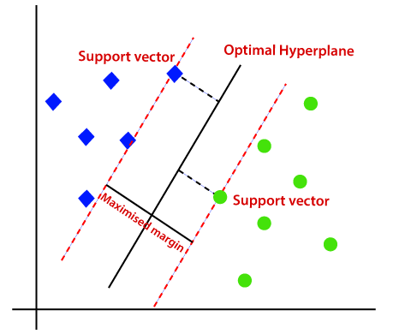
Examples of Machine Learning Algorithms
Decision Trees: Tree-like structure where decisions are made based on features for classification and regression tasks. (Choose whether to wear a jacket, long sleeves, or shorts based on weather features like temperature and rain.
SVM Algorithm: Represents data as points in high-dimensional space (Siri and Google Assistant use SVM to recognize voice command – Also for hand and facial recognition)

Slide 11
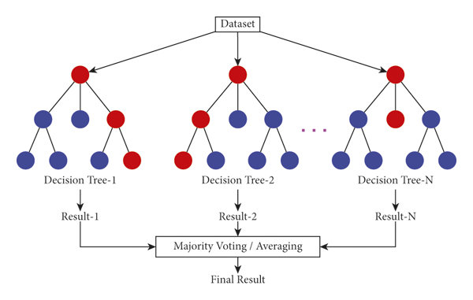
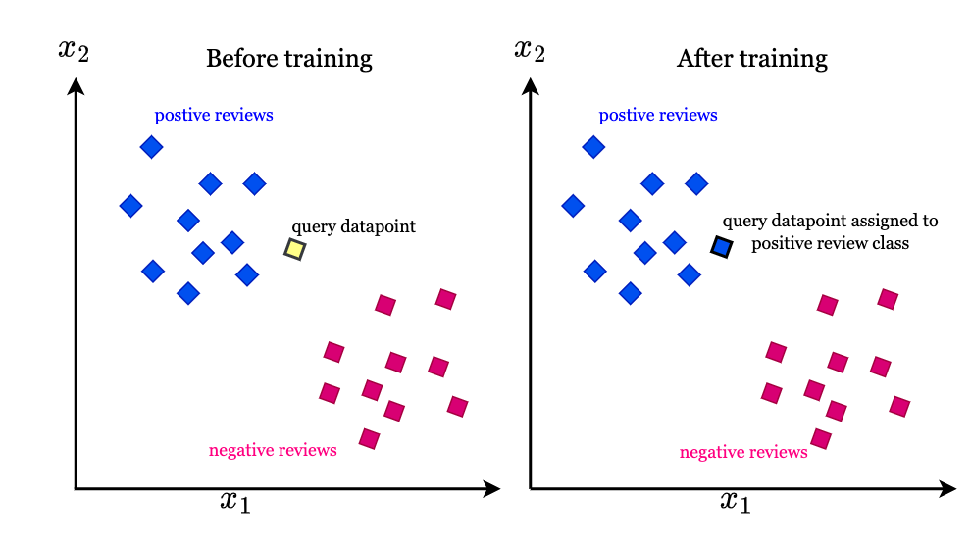
Examples of Machine Learning Algorithms
Random Forest Algorithm: Ensemble of decision trees used for classification and predictive modelling. (Classifying whether an email is “spam” or “not spam”)
KNN Algorithm: Used for both classification and regression problems (also for prediction tasks). (Recommending products to users based on their past purchases)

Slide 12
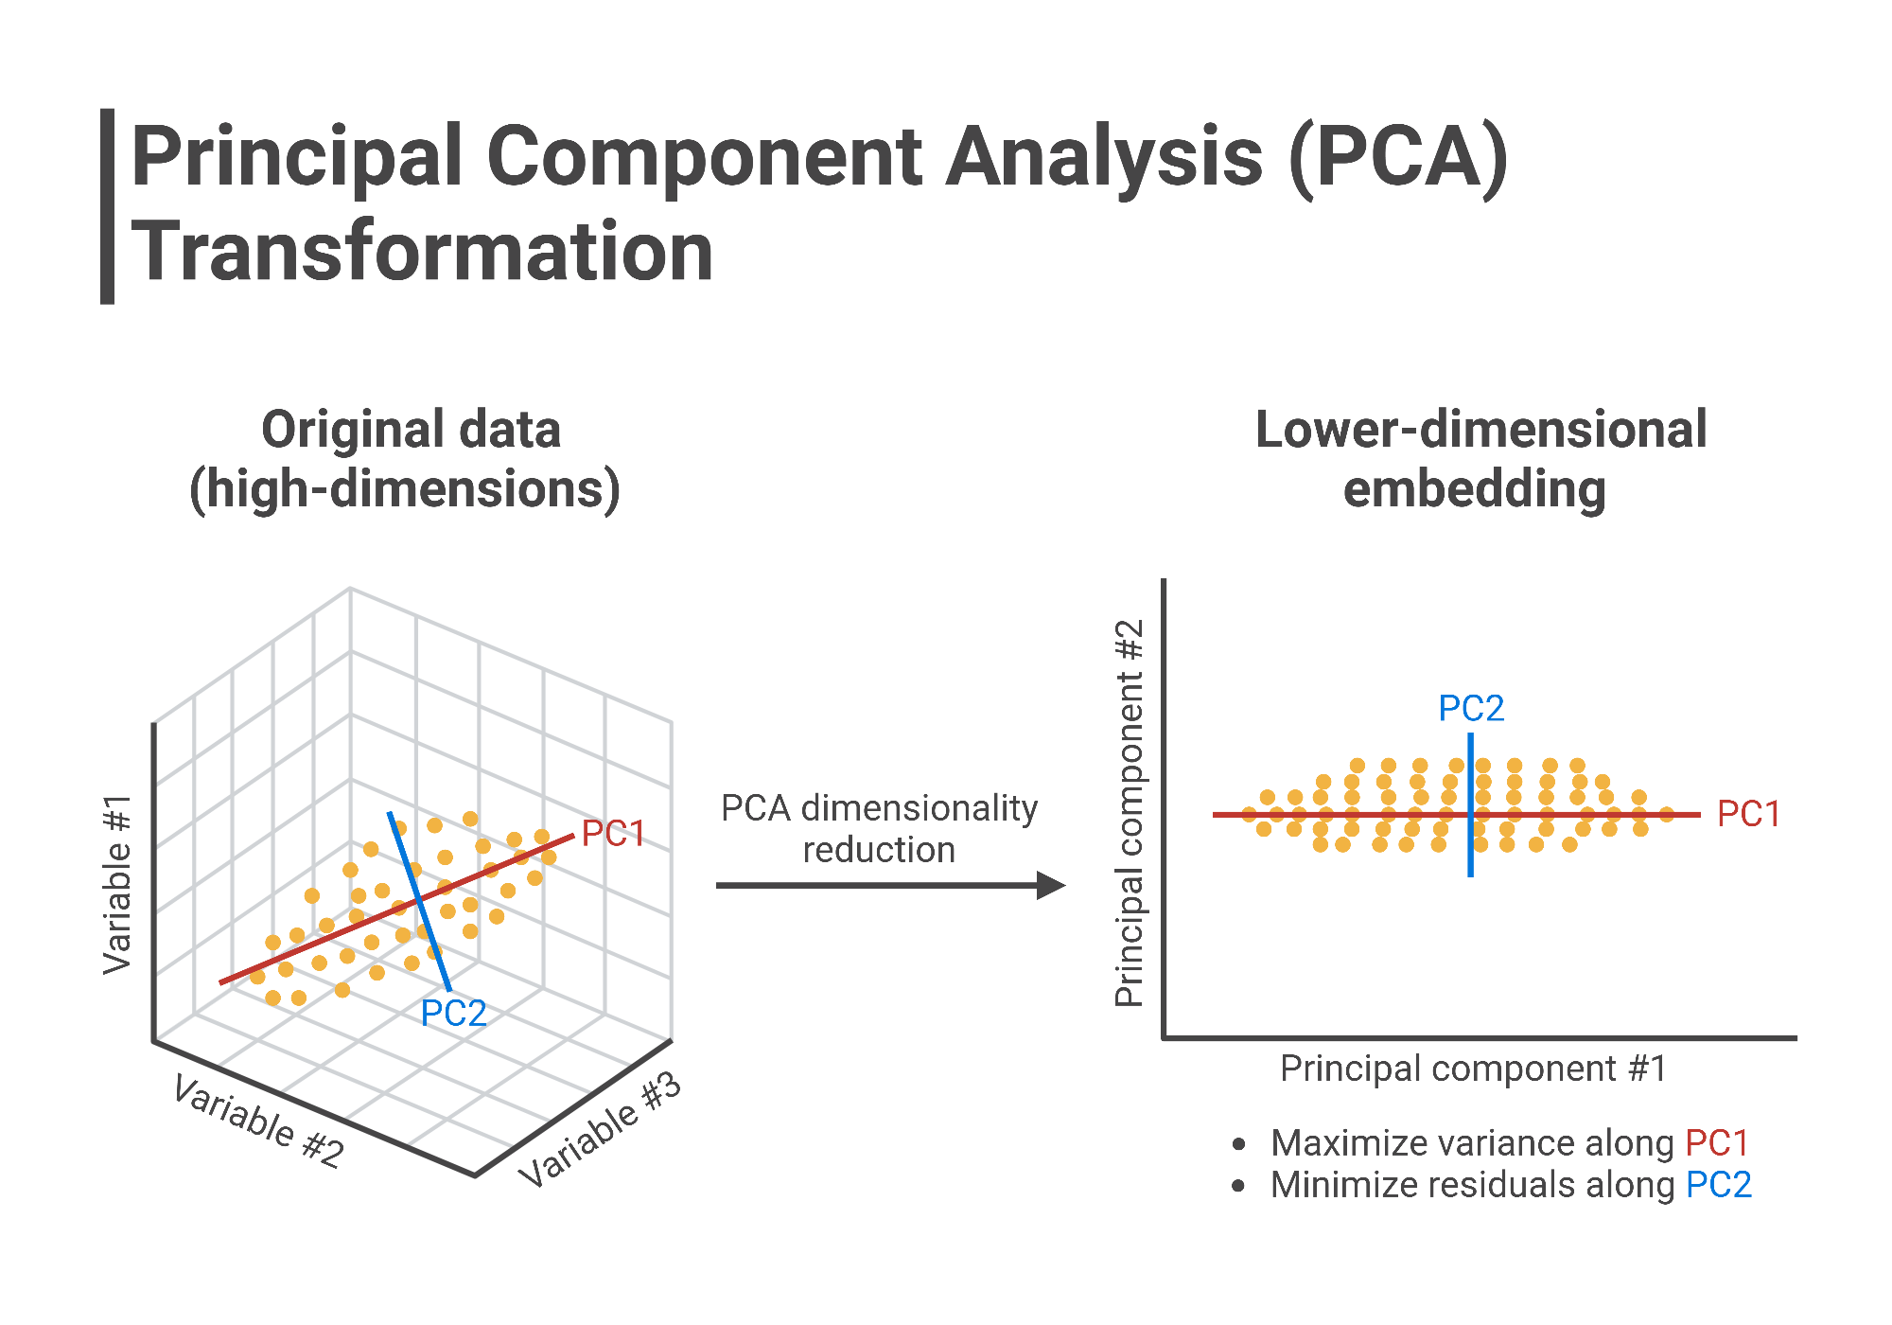
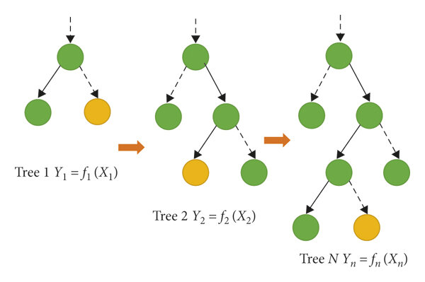
Examples of Machine Learning Algorithms
Principal Component Analysis: Linear reduction method that transforms a complex dataset into a simpler one. (Images can have large datasets with high dimensionality-difficult to store; PCA reduces the dimensionality while preserving important features)
Gradient Boosting Algorithm: Optimization algorithm that reduces cost/loss function for complex problems and large datasets; it works by using multiple weaker learners (decision trees) to try and create a stronger learner. New decision trees are added to model and are adjusted based on errors of existing trees. (Facial recognition, Ranking, NLP)

Slide 13
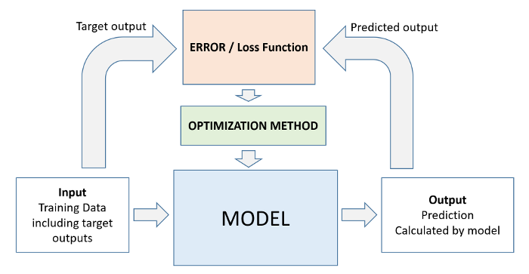
Components and Workflow of a Machine Learning System
Machine Learning Models are trained with existing data so that when new data comes in, they can make predictions/decisions with a certain degree of accuracy based on past (learned) data.

Slide 14
Modes of Machine Learning
There are two main modes of machine (deep) learning:
Supervised Learning is the learning approach that utilizes labeled data sets to train the model to classify data and predict outcomes. In supervised learning, the labeled dataset includes output that is tagged to corresponding input data to train the model to recognize unseen data.
Unsupervised Learning is a type of machine learning in which the model is provided data that does not contain any labels or explicit instructions on what to do with the data. The goal is for the model to find a structure in the input data on its own.

Slide 15
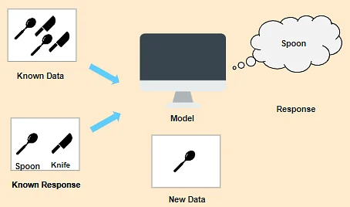
Supervised Learning
Applications of supervised learning include:
Image Recognition, Medical Diagnosis, Sentiment Analysis, Natural language Processing, Spam detection, Financial Fraud Detection, and others…
Classification problems : the output, consisting of classes/categories, predicts what objects are present in the input (cat, dog, horse, etc…)
Regression problems : the predicted output values are real numbers like predicting the
price of a house, finding the parameters for best fit into a given data set, etc…

Slide 16
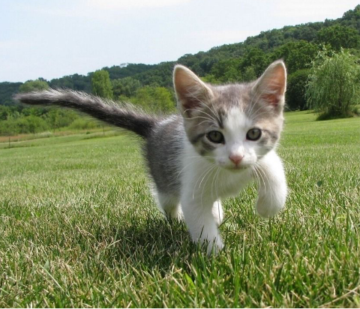
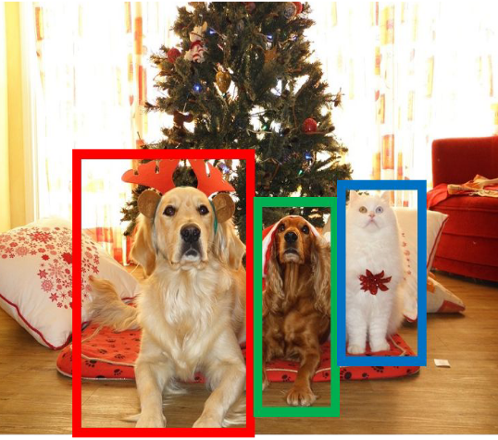

CAT
classification
Supervised Learning Data:
(x, y) x is data, y is label
Goal:
Learn a function to map x -> y
Examples: Classification, regression, object detection, semantic segmentation, image captioning, etc.
DOG, DOG, CAT
Object Detection
GRASS, CAT, TREE, SKY
Semantic Segmentation

Slide 17
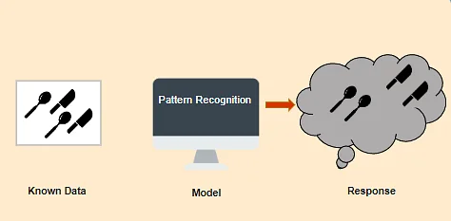
Unsupervised Learning
Applications of unsupervised learning include:
Customer Segmentation, Anomaly Detection, Image and Document Clustering, Market Analysis, Recommender Systems, Dimensionality Reduction, Natural Language Processing, Clustering, and others…

Slide 18
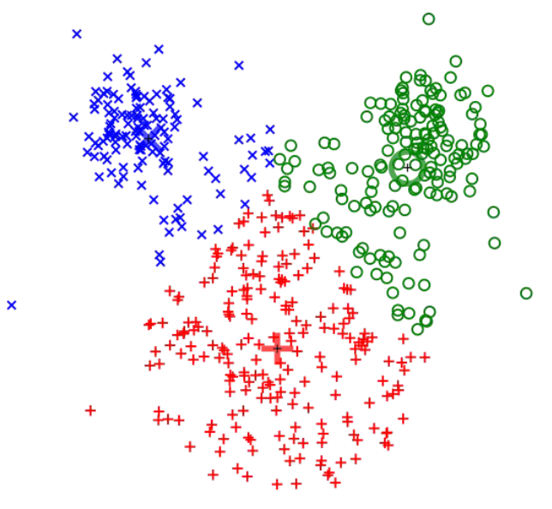
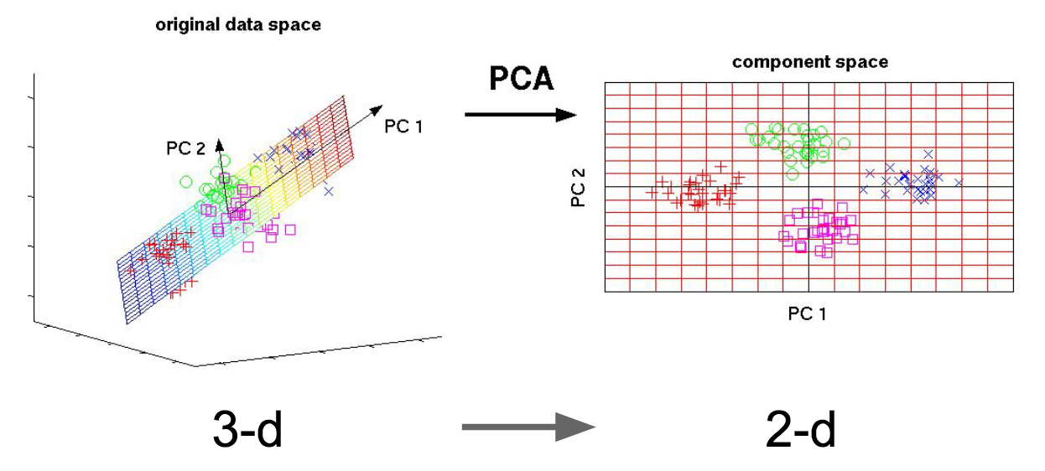
Unsupervised Learning Data:
x Just data, no labels!
Goal:
Learn some underlying hidden structure of the data
Examples: Clustering, dimensionality reduction, density estimation, etc.
K-means clustering
Principal Component Analysis (Dimensionality reduction)

Slide 19




Workflow of Machine Learning
Data
Model
Optimization
Evaluation
Data
4. Launch!
1. Study the problem
2. Train ML model
3. Evaluate
4. Analyze errors

Slide 20
Main challenges of ML
In ML the main task is to select a Model and to Train it on some Data prior to deployment. The two things that can go wrong are: “bad model” or “bad data”.
Bad Data:
Insufficient Quantity of Training Data (it takes a lot of data to work properly)
Nonrepresentative Training Data (inaccurate predictions)
Poor-Quality Data (full or errors, outliers, noise)
Irrelevant Features (garbage in, garbage out)

Slide 21
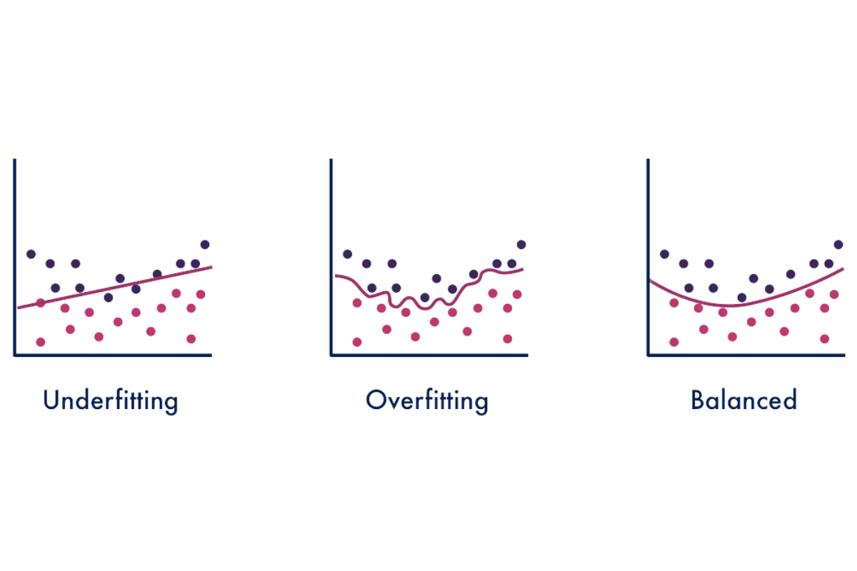
Main Challenges of ML
2. Bad Model:
Overfitting the Training Data
Underfitting the Training data

Slide 22
Summary
Machine Learning is about making machines get better at some task by learning from data, instead of having to explicitly code rules.
There are several types of machine learning systems: supervised or unsupervised, batch or online, instance-based or model-based. An ML project requires:
Gathering data in a training set
2. Feeding the training set to a learning algorithm
If the algorithm is model-based, it tunes internal parameters to fit the model to the training set (makes good predictions on the training set)
If the algorithm is instance-based, it just learns the examples by ‘heart’ and generalizes to new instances by using a similarity measure to compare them to the learned instances.
Evaluating the trained algorithm
The system will not perform well if the training set is too small, or if the data is not representative
The model/algorithm needs to be neither too simple (to avoid underfitting) not too complex (to avoid overfitting).

Slide 23
Testing and validating
Machine Learning models are tuned on training data and are tested on testing data.
It is generally common to used 80% of the data available for training and the remaining 20% for testing the model.
ML models have intrinsic parameters that are internal and get tuned through training and hyperparameters that are applied to the model to serve a desired purpose or performance.
Typically, we train models with various hyperparameters and select the model that performs a given task best on a validation set.
A well trained/tuned ML model is one that performs well on a validation set.

Slide 24
Exercises:
What are two most common supervised tasks?
Name four common unsupervised tasks?
What type of algorithm would you use to segment your customers into multiple groups?
Is the spam detection task a supervised or unsupervised learning problem?
What type of algorithm relies on similarity measure to make predictions?
Search and describe four types of model hyperparameters and their role in the model’s performance.
What is the difference between a model parameter and a model hyperparameter?
Search and find a specific example of an underfitting machine learning algorithm.
Search and find a specific example of an overfitting machine learning algorithm.
What are four of the main challenges in machine learning?
What is a loss function?
What is a regression algorithm? Give a specific example.
What is a classification algorithm? Give a specific example.
What is a training dataset?
What is a test dataset? What do we want to use it?
What is the purpose of a validation set?

Slide 25
References
Deep learning by Ian Goodfellow, Yoshua Bengio, and Aaron Courville
Hands-On ML with Scikit-Learn, Keras, and TensorFlow (Aurelien Geron)
Machine Learning with Python by Bernd Klein
LAPENNA Workshop (UTK) by Kwai Wong
6S191 MIT Deep Learning Lecture 1 by Alexander Amini

